Slide 1

Water Quality Analysis
Megan Flinders
Jason Napier
Kaitlynn Nguyen

Slide 2
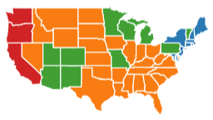

Is there a relationship between a state’s water quality and their population demographic?
In this analysis, we looked at the level of contamination of 3 of the major pollutants in the community water systems of 25 of the states, and compared it to some of the population demographics of those states (income, poverty rate, education and unemployment).

Slide 3
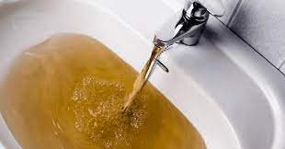
Hypothesis
Going into this analysis, we believed we would see lower quality of water (higher contamination levels) in states with populations of lower median income levels and higher poverty rates
We also believed we would see higher contamination levels in the water systems of states with higher unemployment rates, as well as those states with a higher percentage of adults with education levels of less than a high school diploma
If a state’s population has lower income and education levels, as well as higher poverty and unemployment rates, then there will be higher contamination levels in their community water systems

Slide 4
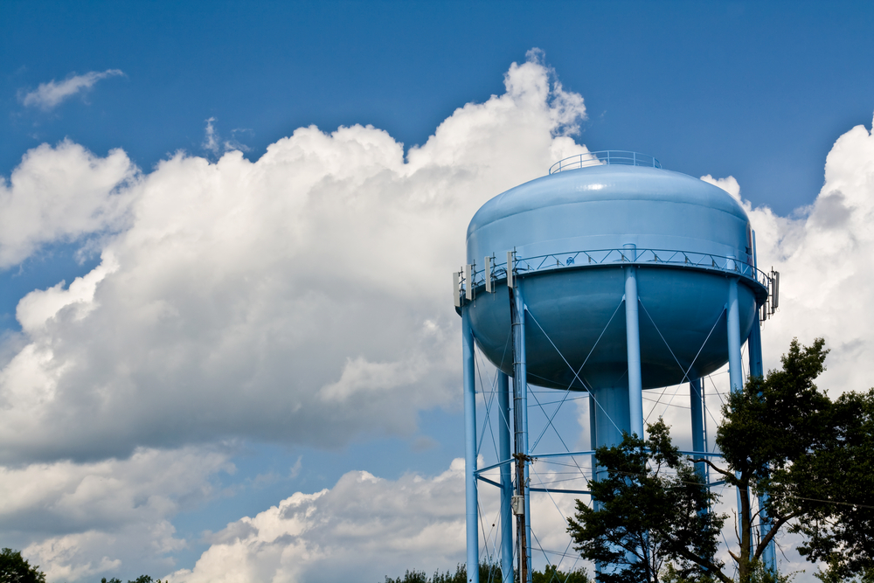

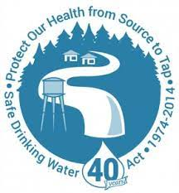
Water Sources
When analyzing water quality data, we wanted to look at the sources of water that most directly impact communities
Over 90% of Americans get their tap water from community water systems
Community water systems are public water systems that supply water to the same populations year-round
American drinking water quality is subject to EPA regulations and rules set forth by the Safe Drinking Water Act

Slide 5
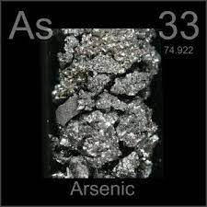
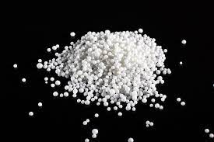
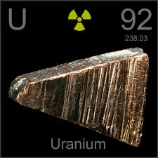
Water Contaminants
 | Health Risks | EPA Standards | Contamination Sources
Arsenic | Can cause cancer, skin lesions, cardiovascular disease and diabetes | 10 micrograms per liter (µg/L) | Natural mineral deposits, industrial and agricultural wastewater
Nitrates | Can cause cancer, thyroid disease and birth defects | 10 milligrams per liter (mg/L) | Runoff/fertilizers, wastewater, landfills, animal feed lots, septic systems and urban drainage
Uranium | Can cause cardiovascular disease, kidney damage and lung cancer | 30 micrograms per liter (µg/L) | Natural mineral deposits, mining, fertilizers, nuclear facilities and military activities

Slide 6
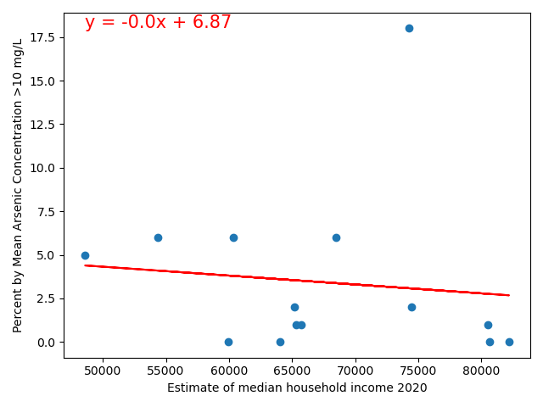
Arsenic vs Income
Negative regression line
r-squared: .0037
Notes:
Little to no relationship

Slide 7
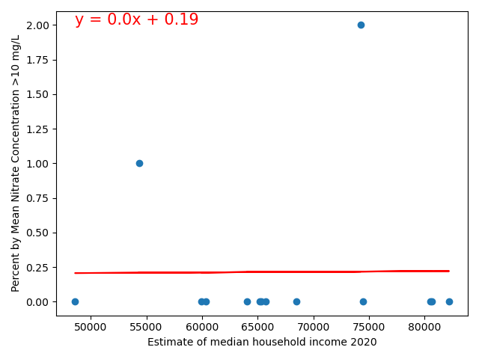
Nitrate vs Income
Flat regression line
r-squared: .0004

Slide 8
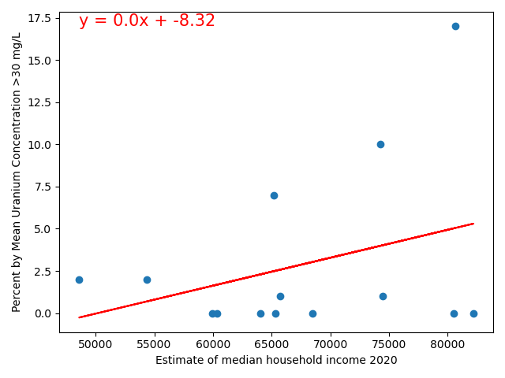
Uranium vs Income
Positive regression line
r-squared: .0854

Slide 9
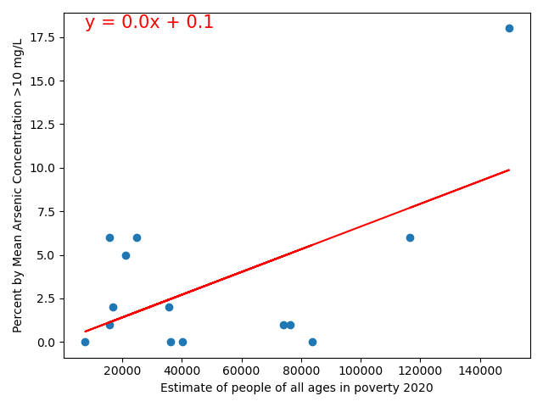
Arsenic vs Poverty Rate
Positive regression line
r-squared .3730
Notes:
Some relationship

Slide 10
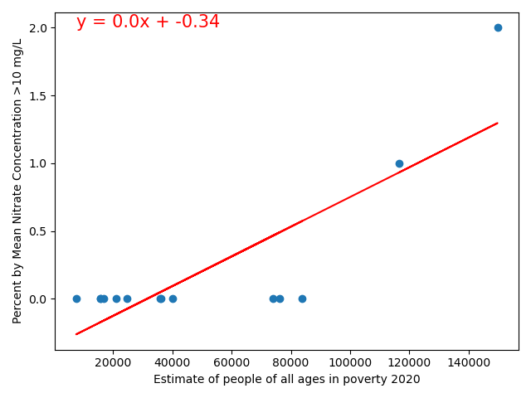
Nitrate vs Poverty Rate
Positive regression line
r-squared: .6468

Slide 11
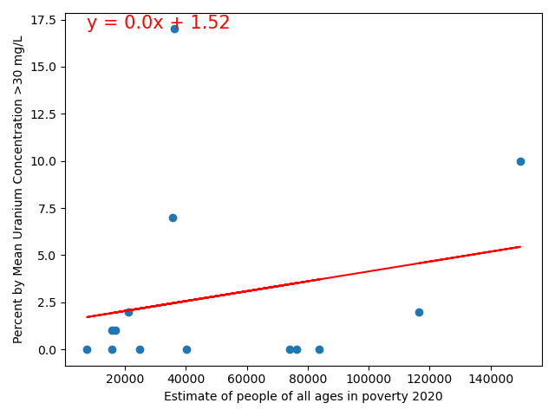
Uranium vs Poverty Rate
Positive regression line
r-squared: .0820

Slide 12
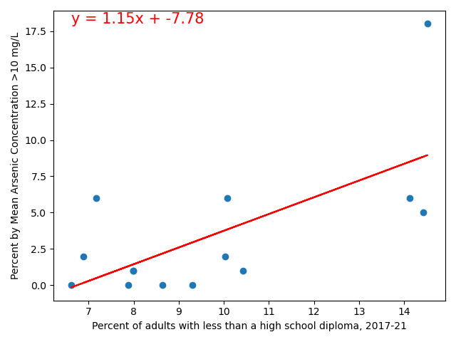
Arsenic vs Education
Positive regression line
r-squared: .3710
Notes:
Some relationship

Slide 13
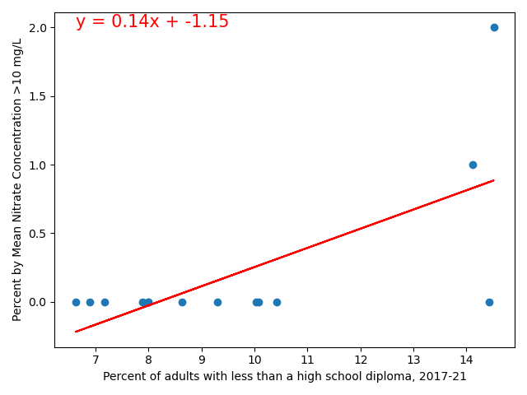
Nitrate vs Education
Positive regression line
r-squared: .3974

Slide 14
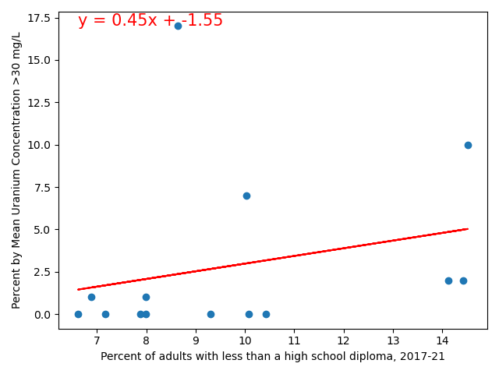
Uranium vs Education
Positive regression line
r-squared: .0637

Slide 15
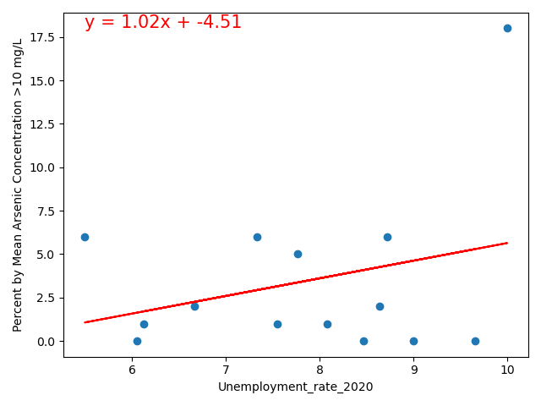
Arsenic vs Unemployment
Positive regression line
r-squared: .1461
Notes:
Some relstionsip

Slide 16
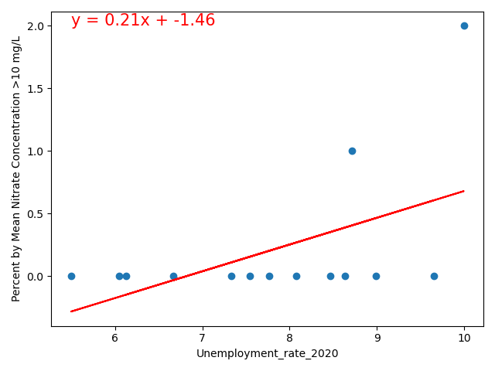
Nitrate vs Unemployment
Positive regression line
r-squared: .2662

Slide 17
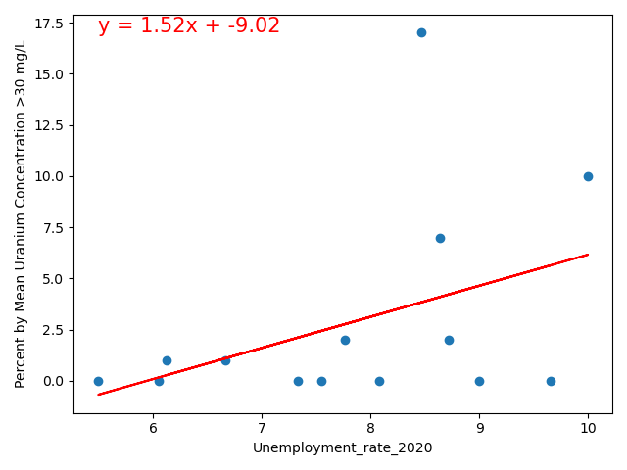
Uranium vs Unemployment
Positive regression line
r-squared: .2208

Slide 18
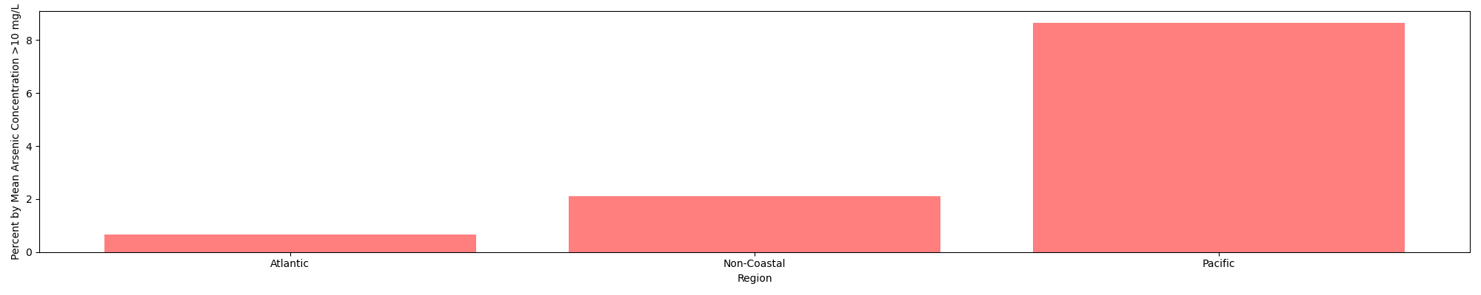
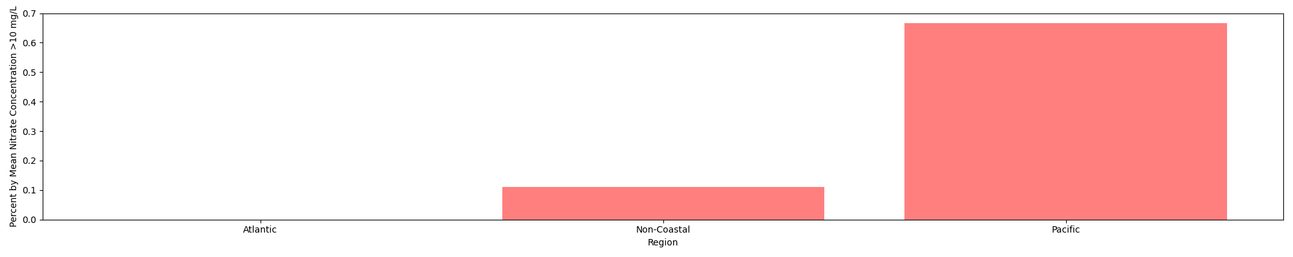
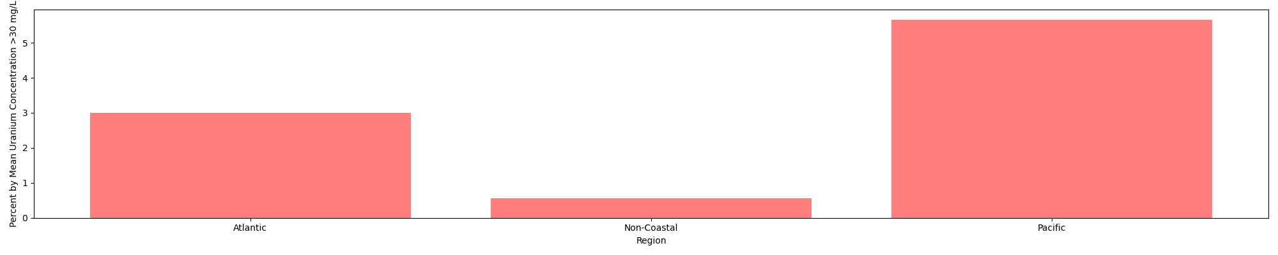
Contamination by Region
Arsenic
Nitrates
Uranium

Slide 19
Conclusions
While we did not have enough data to make any statistically significant conclusions about the relationship between a community’s water quality and their population demographic…
There tended to be higher contamination levels in states with higher unemployment and poverty rates
In states with higher percentages of adults with less than a high school education, there tended to be higher contamination levels in their community water systems
When it comes to income level, we saw more flat and even negative regression lines, meaning contamination levels tended to be the same or even lower in higher income areas (with the exception of uranium)
We can also see that Pacific Coast states consistently have higher levels of contamination of all 3 pollutants in their community water systems than Atlantic Coast and Non-Coastal states

Slide 20
Limitations of Analysis
We were only able to obtain data for half of the U.S. states
We only analyzed the levels of 3 different contaminants
We only looked at one source of water data: community water systems

Slide 21
Usage of Analysis
This Water Quality Analysis is to be used for educational and research purposes
Can be used to look at average contamination levels of 3 specific pollutants in community water systems in 3 different regions of the United States: Atlantic Coast states, Pacific Coast states and Non-Coastal States

Slide 22


Sources
Water quality data was obtained from the CDC
State demographic data was obtained from the U.S. Department of Commerce, Bureau of the Census
Water quality regulation information came from the EPA and CDC

